Slide 1
UNIT 3-PART I. ORM
HIBERNATE TOOLS

Slide 2
Unit 3 links
https://en.wikipedia.org/wiki/Object-relational_mapping
https://www.tutorialspoint.com/hibernate/orm_overview.htm

Slide 3
1. ORM TOOLS
An ORM is an object relational mapping tool that can be used for making CRUD operations (Create, Read, Update and Delete operations) to databases much simpler and efficient by configuring xml files to carry out their work.
Java is an object oriented programming language which works with a set of objects. A relational database is represented in a tabular format using rows and columns. So, when a program has to save an object in a database, there is some obvious mismatch and to handle this mismatch we have Object Relational Mapping(ORM).

Slide 4
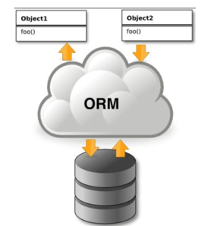
2. ORM ADVANTAGES OVER JDBC
1 Let’s business code access objects rather than DB tables.
2 Hides details of SQL queries from OO logic.
3 Based on JDBC 'under the hood.'
4 No need to deal with the database implementation.
5 Entities based on business concepts rather than database structure.
6 Transaction management and automatic
key generation.
7 Fast development of application.

Slide 5
3. JAVA ORM FRAMEWORKS
There are several persistent frameworks and ORM options in Java. A persistent framework is an ORM service that stores and retrieves objects into a relational database.
Enterprise JavaBeans Entity Beans
Java Data Objects
Castor
TopLink
Spring DAO
Hibernate
And many more

Slide 6
4. HIBERNATE
Hibernate is an Object-Relational Mapping (ORM) solution for JAVA. It is an open source persistent framework .
Hibernate maps Java classes to database tables and from Java data types to SQL data types and relieves the developer from 95% of programming tasks related to common data persistence.
It’s the most widely used ORM tool for Java.

Slide 7
Hibernate Advantages
Hibernate takes care of mapping Java classes to database tables using XML files and without writing any line of code.
Provides simple APIs for storing and retrieving Java objects directly to and from the database.
If there is change in the database or in any table, then you need to change the XML file properties only.
Hibernate does not require an application server to operate.
Manipulates Complex associations of objects of your database.
Minimizes database access with smart fetching strategies.
Provides simple querying of data.(HQL)

Slide 8
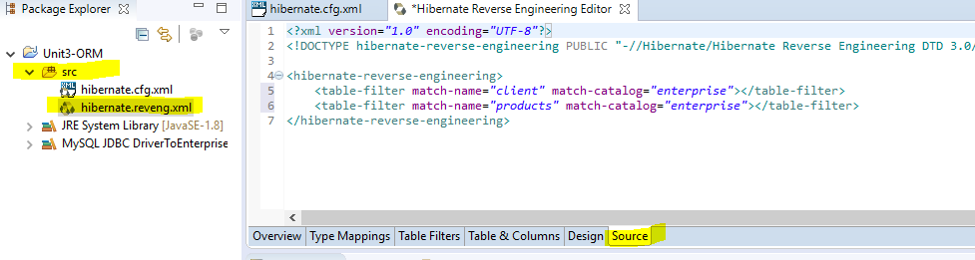
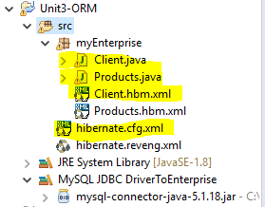
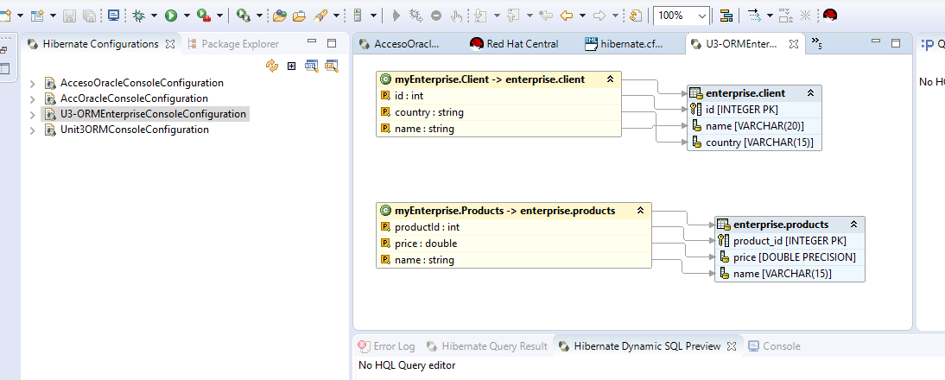
PRACTICE 3.1. INSTALLING HIBERNATE

